Slide 1
ACL2021
Code: None
2022.01.16 • ChongQing
Reported by Changjiang Hu

Slide 2
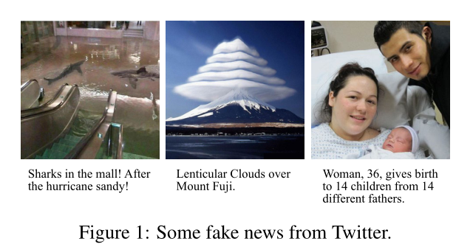
Introduction
Weaknesses in recent research work
(1) ignore the individual information of fake images at the physical level,e.g.,re-compression artifacts, which is reflected in the frequency domain
(2) However, existing state-of-the-art methods are weak to fuse multimodal features due to their neglect of inter modality interactions

Slide 3
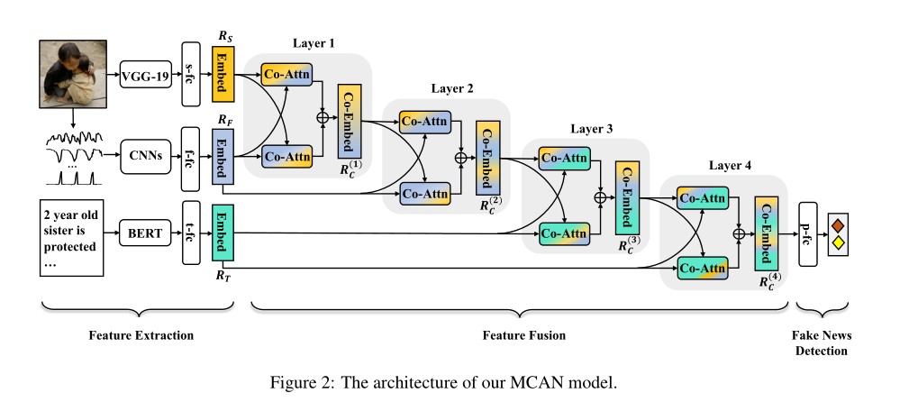
Method

Slide 4
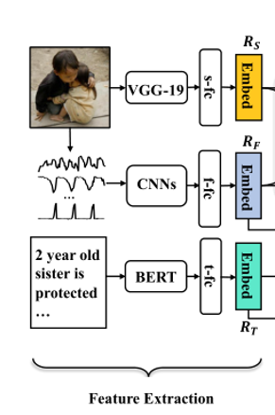
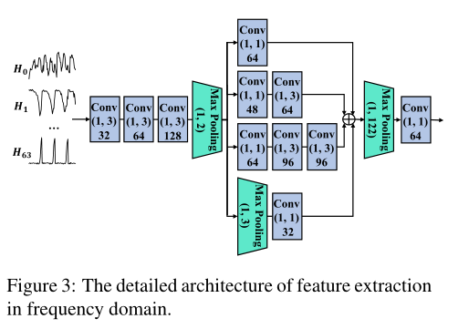
Method
Spatial-Domain Feature
Frequency-Domain Feature
Textual Feature

Slide 5
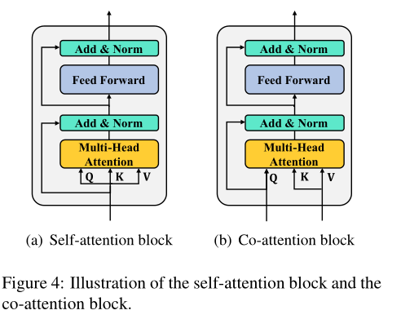
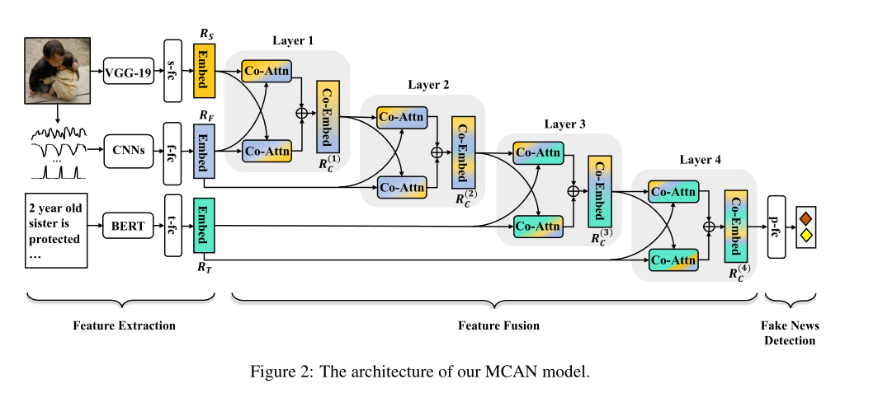
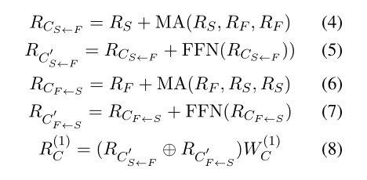
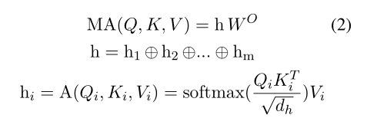
Method

Slide 6
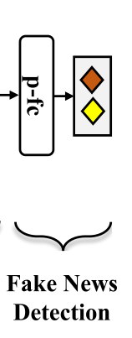
Method
Model Learning
Let ,which is used to predict. The output of the proposed MCAN is the probability of a tweet being fake:

Slide 7
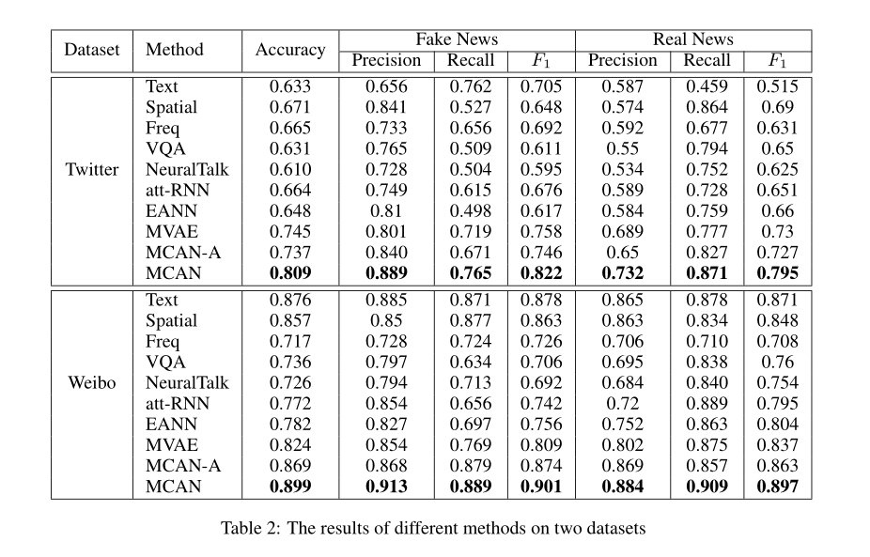
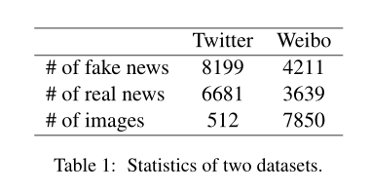
Experiment

Slide 8
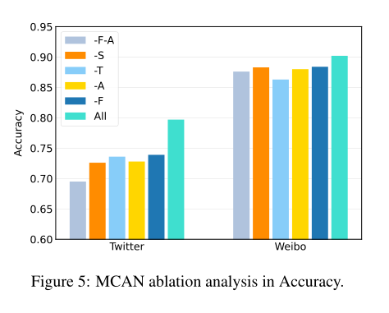
Experiments

Slide 9
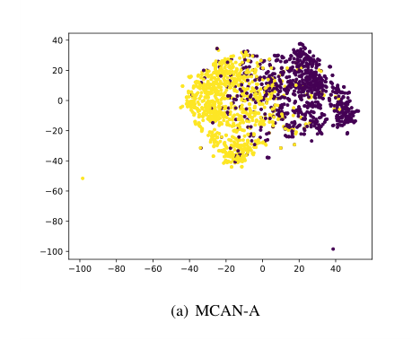
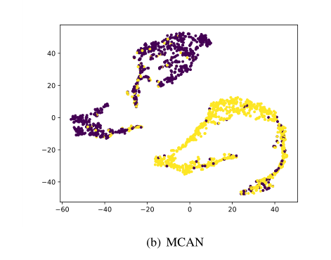
Experiments
To illustrate the effectiveness of co-attention layers in MCAN, we qualitatively visualize the joint representation of three modalities learned by MCAN-A and the fused representation
learned by MCAN on Weibo testing set with t-SNE (Maaten and Hinton, 2008), as shown in Figure 6. The label of each tweet is real or fake.

Slide 10
Thanks

